Slide 1

OOP’s PROJECT:
Mobile Repair Shop
Presented By
Vivek Yadav
Yash Thenuia

Slide 2
INTRODUCTION
Mobile Repair Shop is a simple project showing the implementation of basic concepts of Object Oriented Programming language..
The language used in this project is C++. This project is very easy to understand, and will help you learn how to create class and object in C++ .
Here, the user can perform tasks like
Show list of Records
Enter their mobile’s information
Can modify their entered details
Show private information
Show total bill generated

Slide 3
Member Functions
Add Customer: This feature allows you to add a new customer with their details like their Unique number, Name, Address, Phone no, Email ID, type of defects in their mobile, defects charges etc.
Remove Customer: This feature allow you to remove customer from the main record list. For removing customer from list, a unique number is required which was assigned to the customer in Add Customer Function.

Slide 4
Member Functions
Modify: This feature allow you to modify details of customer. Details like Name, Address, Phone number, Email ID. This function also requires unique number of customer to modify their details.
Show Records: With this feature you can see records of all customers. This function doesn’t show private information like customer’s Address, Phone number, Email ID. There is another function which show private information.

Slide 5
Member Functions
Serial No: It is a static member function which show Serial No in a list (list like show records, records after removing a customer.
Private Info: It is a Friend function which show sensitive data of customers. Sensitive/ Private information contains address, phone no, email ID.
Total Bill: This function takes customer’s unique no and generate the total bill. It also show their mobile details like type of defects, defects charge.

Slide 6
Different Header Files Used
Iostream: Iostream is used to invoke the commonly used functions like cout, cin in a C++ program. Iostream stands for input output stream.
Conio.h: Conio is used to invoke the functions related to the output of the program like clrscr(), getch() etc. Conio stands for console input output
String.h: string.h is the header file required for string functions like strcat(), strcmp(), strcpy(), strlen().
Stdio.h: This header file is used for standard input/ output operations.

Slide 7
Different Header Files Used
fstream: fstream represents both input Stream and output Stream. So it can read from files and write to files. This header file is used in data file handling.
Ctype.h: The ctype.h header file of the C Standard Library declares several functions that are useful for testing and mapping characters.
Process.h: In this project this header file is used for the function exit().

Slide 8
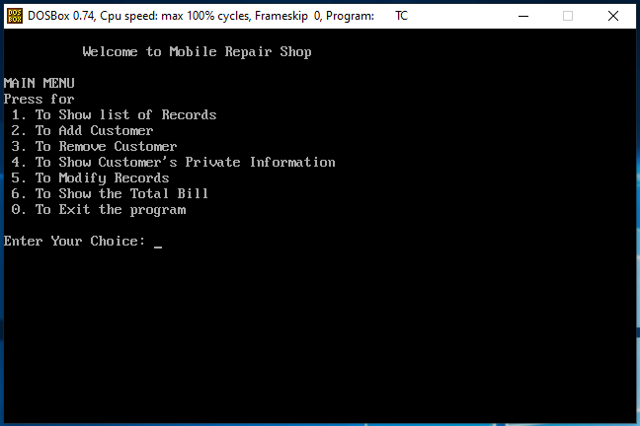
Main Menu

Slide 9
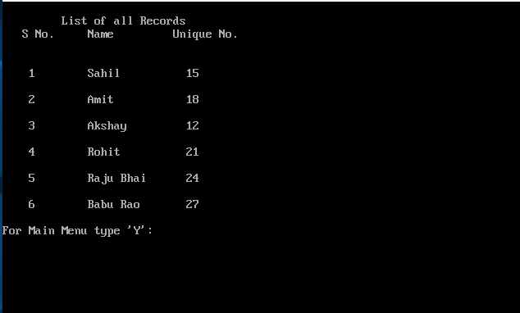
Show List of Records

Slide 10
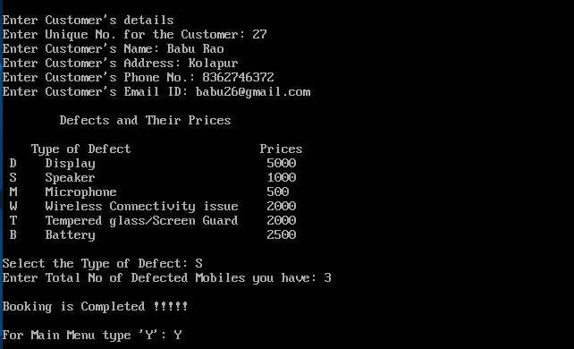
Add Customer

Slide 11
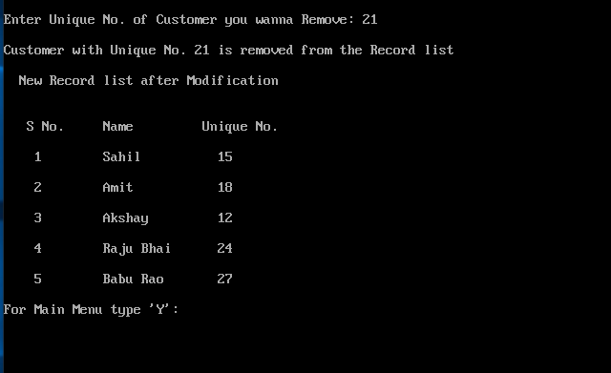
Remove Customer

Slide 12
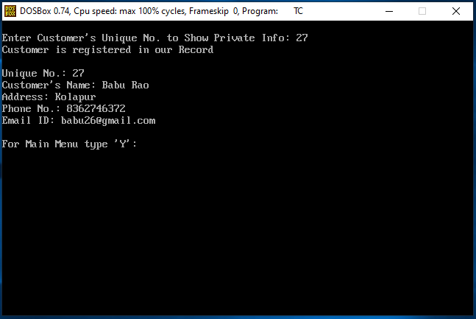
Show Private Information

Slide 13
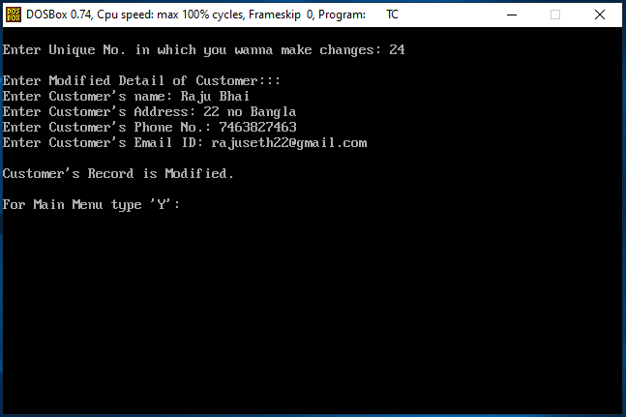
Modify Records

Slide 14
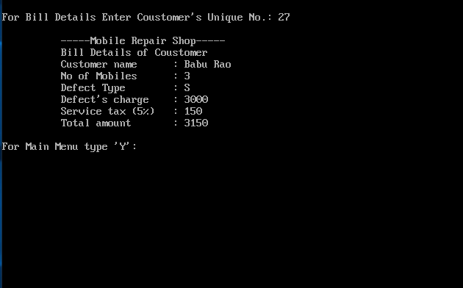
Show Total Bill

Slide 15
Thank You

